Slide 1
COMMUNICATION MAINSTAY
Team Name: Y-NOTS!

Slide 2

COMMUNICATION
Communication
Communication (from Latin commūnicāre, meaning “to share”)
The imparting or exchanging of information by speaking, writing, or using some other medium.

Slide 3
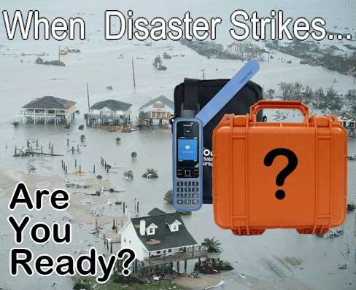
DURING A DISASTER
Communication plays an integral role in disaster management.
Response and Recovery phase needs more information and communicative means.
All conventional methods of communication including telephone, Radio, and Television could be down during a Disaster

Slide 4
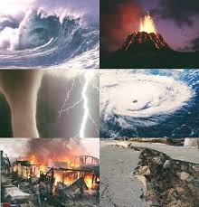
NATURAL DIASTERS

Slide 5
SATELITE COMMUNICATION SYSTEM
Catastrophic events such as hurricanes, earthquakes, floods
and/or fire are usually followed by general madness and the lack of a working communication system makes things even
worse.
Immediate communication is needed for rescue teams and
emergency responders to meet using satellites and satellite
systems.
Satellites wont be affected during a Disaster

Slide 6
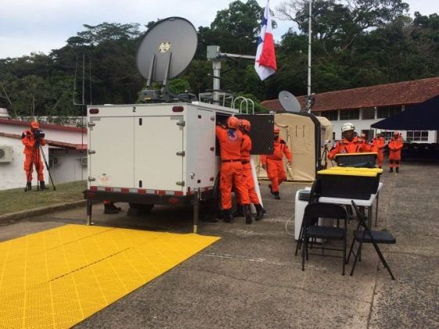
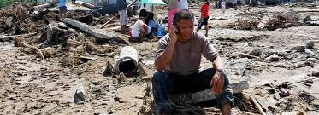

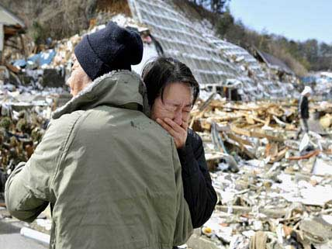

Slide 7
EMERGENCY-ORIENTED INSTANT MESSENGERS AND COMPUTER SCREEN POP-UPs
Personal computer instant messengers is a popular and inexpensive technologies by which to deliver emergency communications to broad or specific audiences in a short period of time.
With this technology, emergency communications will "pop up" on the personal computer screens as a new window that sits on top of any other window that may be open on the screen at the time.

Slide 8
CONCLUSION
Emergencies place demands on communication processes that are often significantly different from the demands of non-emergency circumstances
Emergency communication systems often provide or integrate those same notification services but will also include two-way communications typically to facilitate communications between emergency communications staff, affected people and first responders in the field

Slide 9

Easy come, easy go

